Slide 1

Presented by:
Erick Esparza, Leo Khodel, Liz Maria Panza, Quianna Rolston & Zehra Vahidy

Slide 2
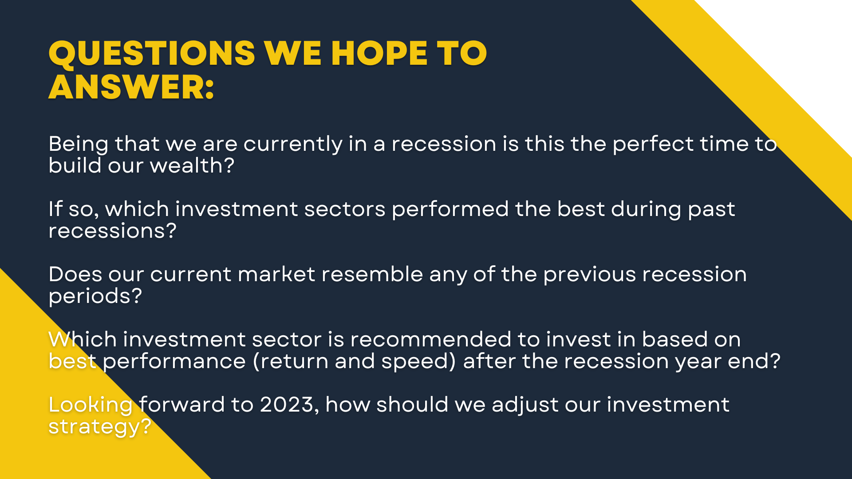

How Do You Build Wealth during a Recession? $$$$$
Being that we are currently in a recession is this the perfect time to build our wealth?
If so, which investment sectors performed the best during past recessions?
Does our current market resemble any of the previous recession periods?
Which investment sector is recommended to invest in based on best performance (return and speed) after the recession year end?
Looking forward to 2023, how should we adjust our investment strategy?
This Photo by Unknown Author is licensed under CC BY-NC

Slide 3
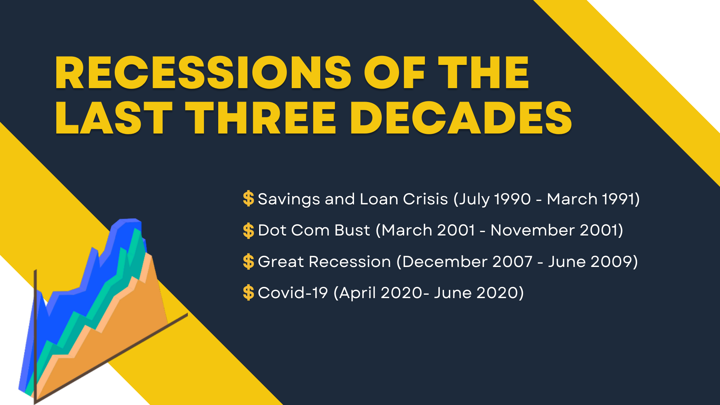
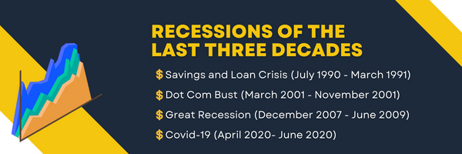

Slide 4
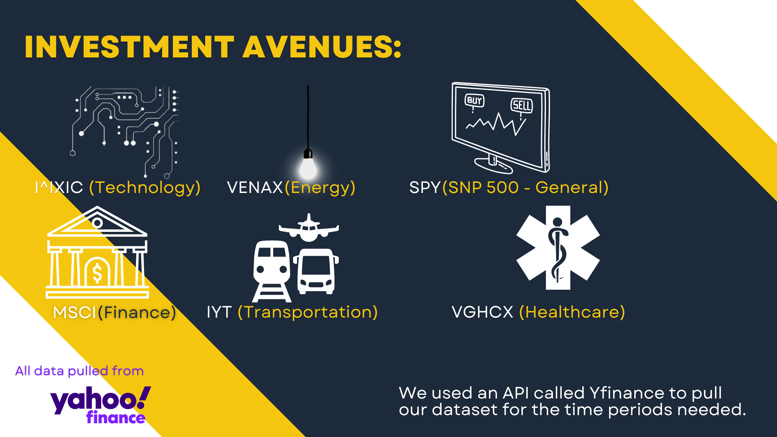



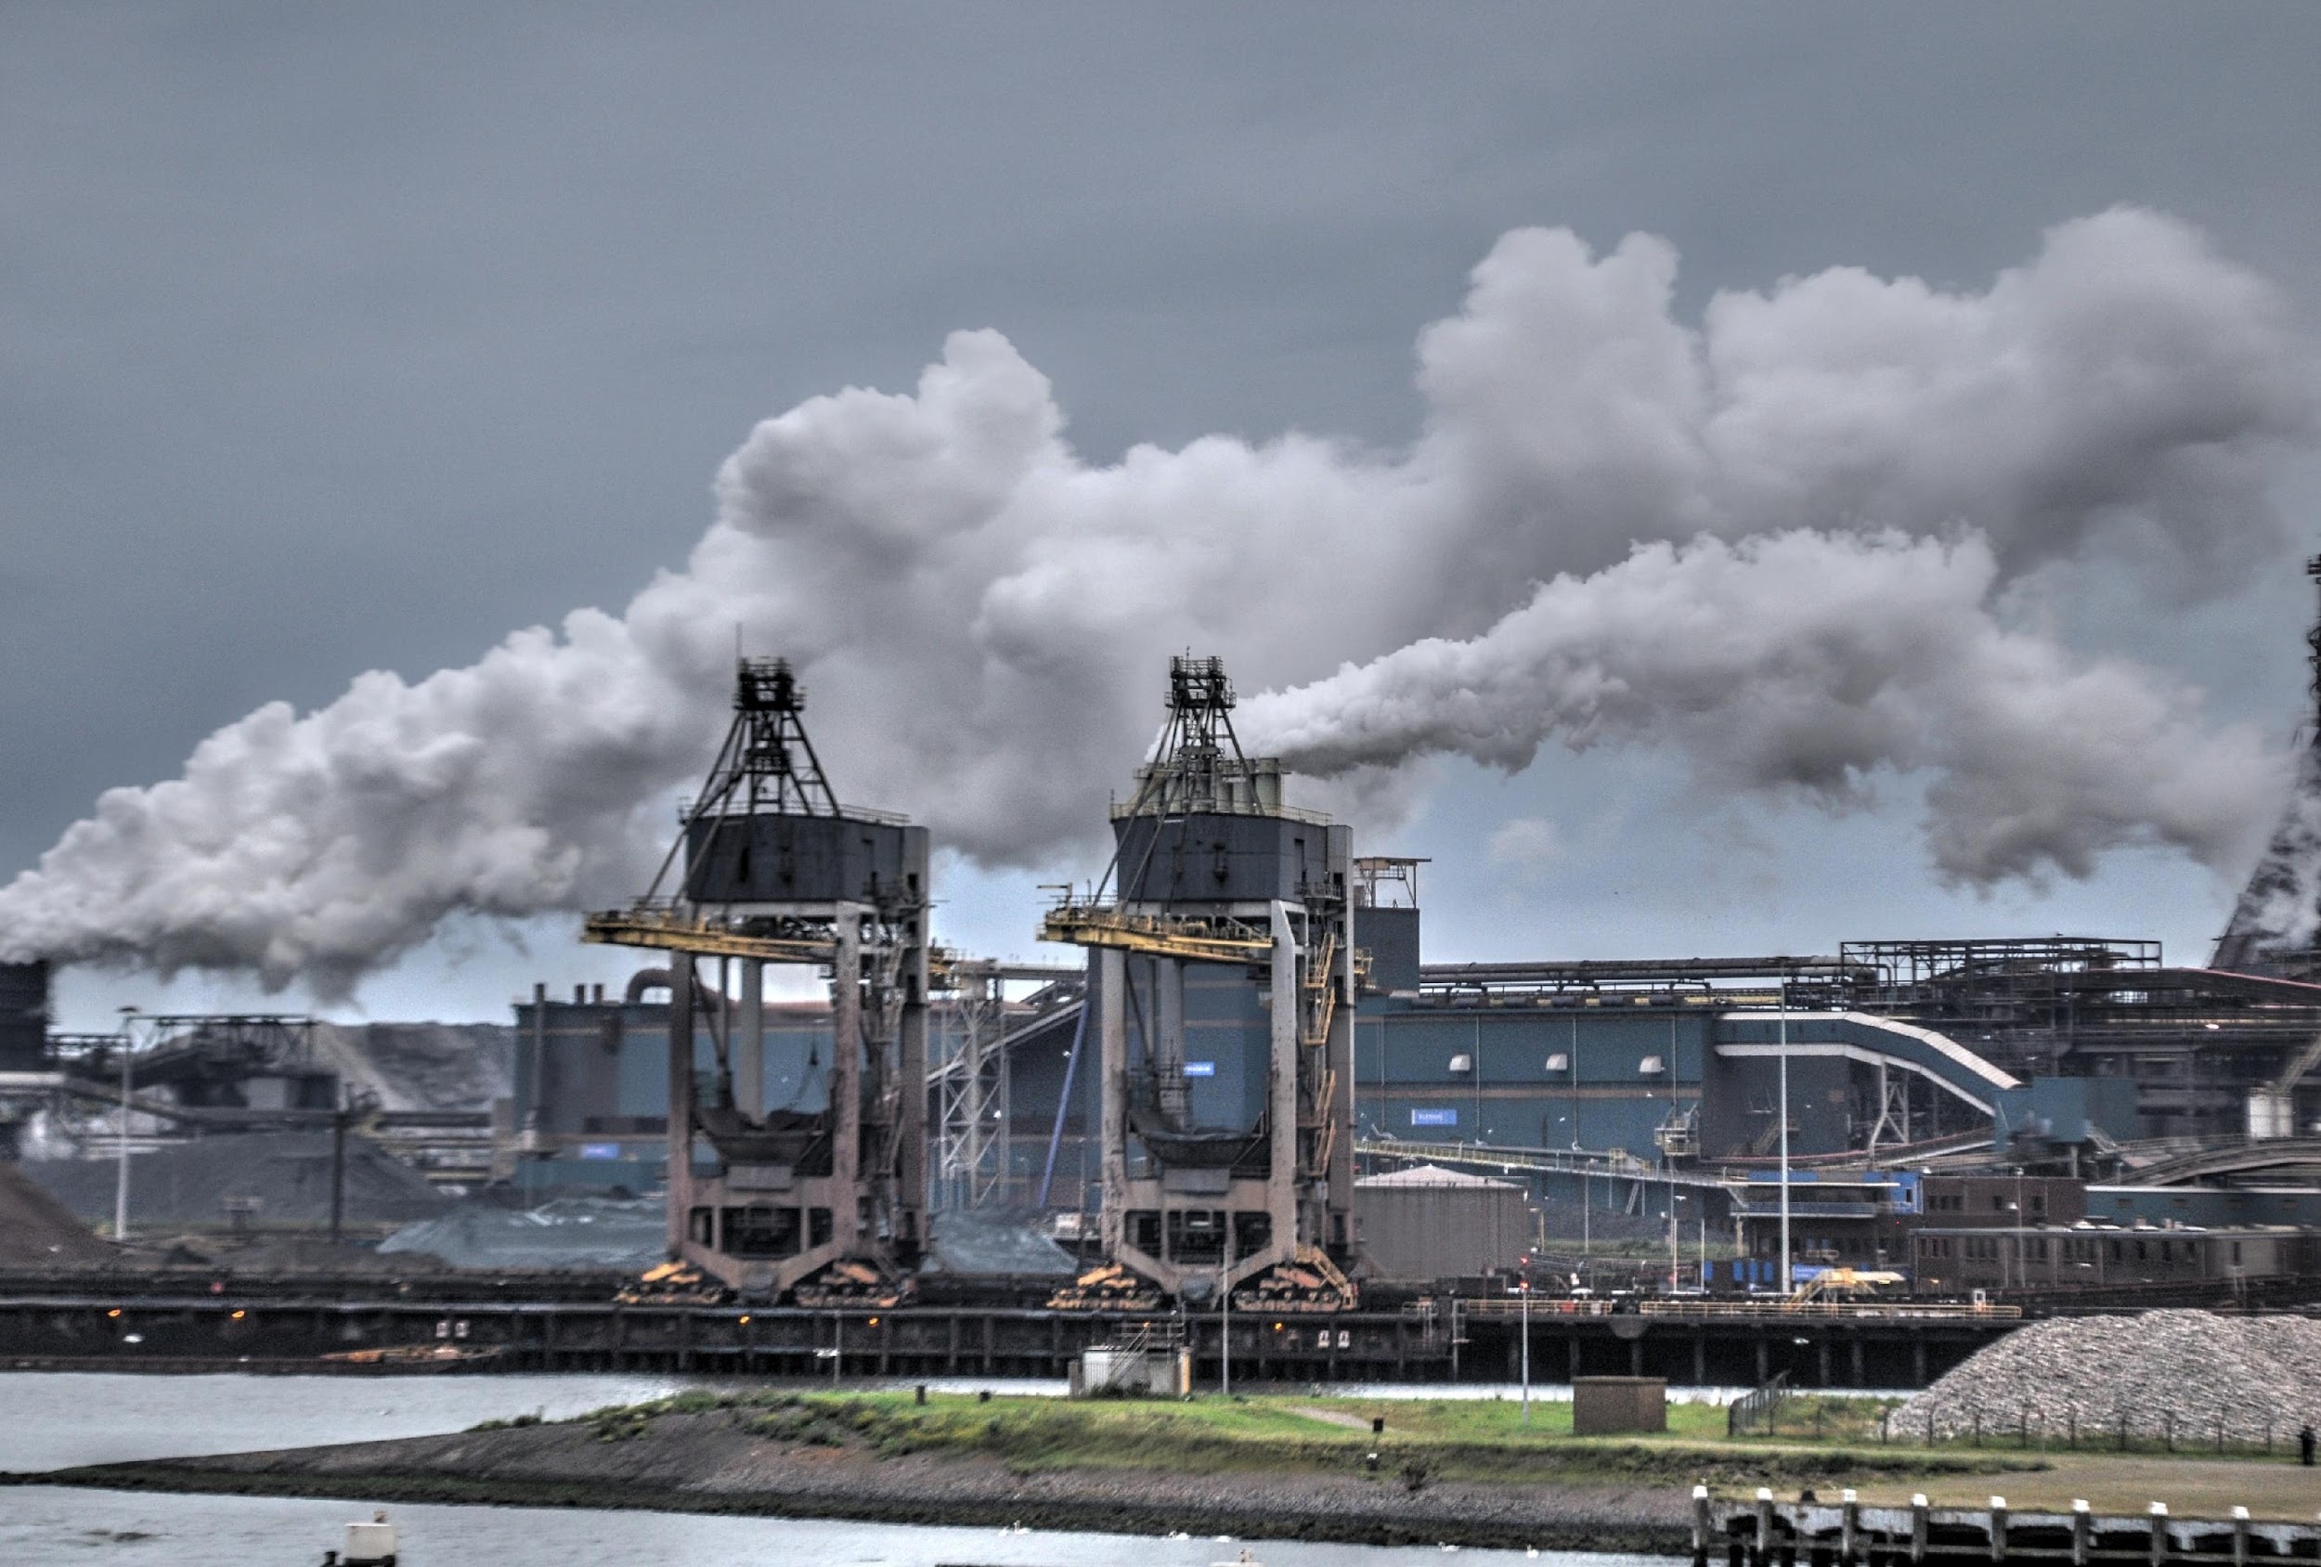


Energy
Healthcare
Technology
Industrial
Commodities
Real Estate

Slide 5
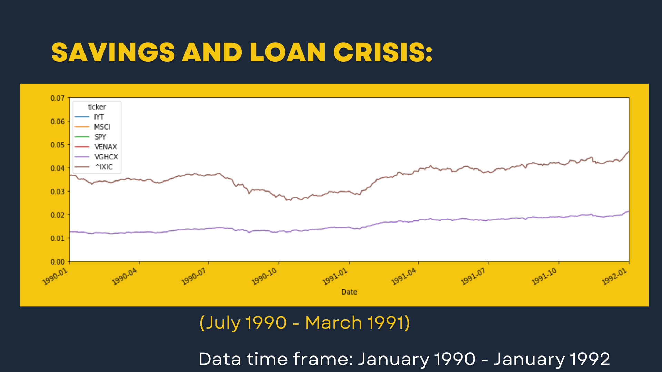
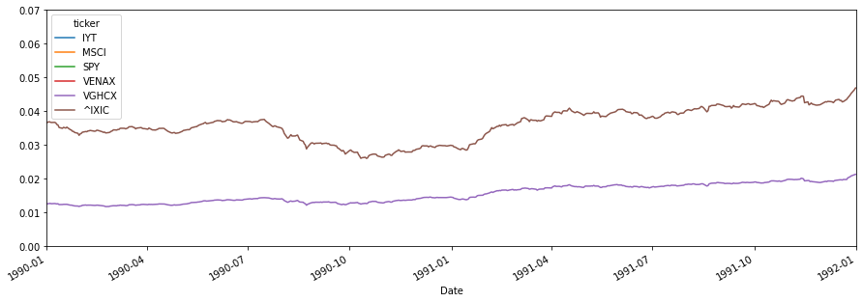
Savings and Loan Crisis
(July 1990 - March 1991)
Data time frame: July 1989 - March 1993

Slide 6
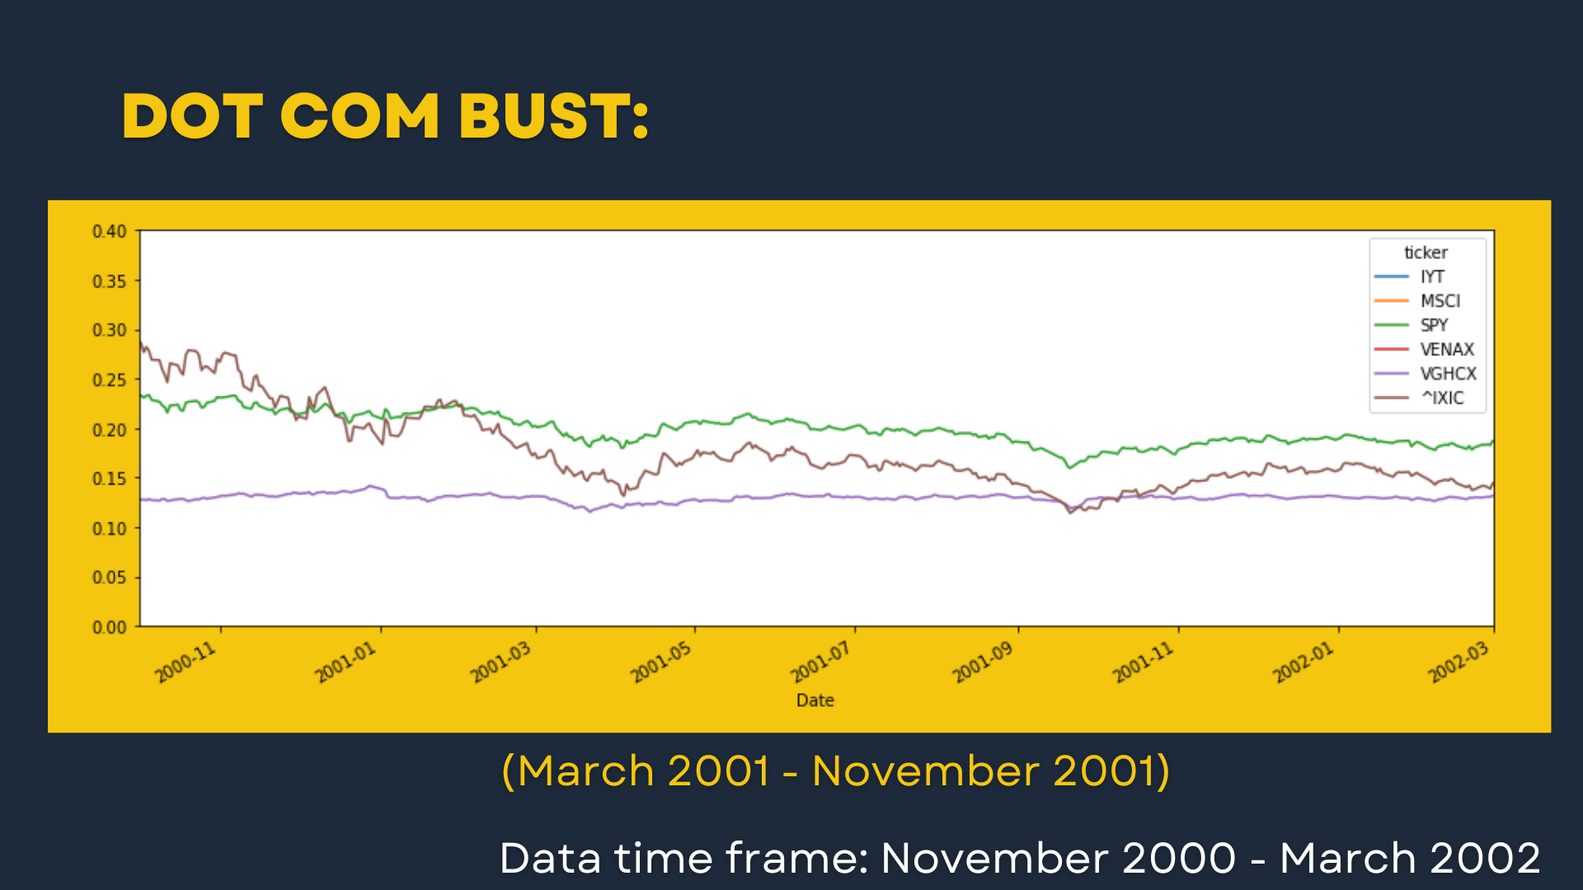
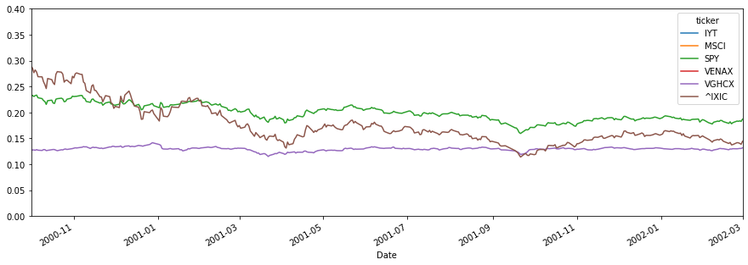
Dot Com Bust
(March 2001 - November 2001)
Data time frame: March 2000 - November 2003

Slide 7
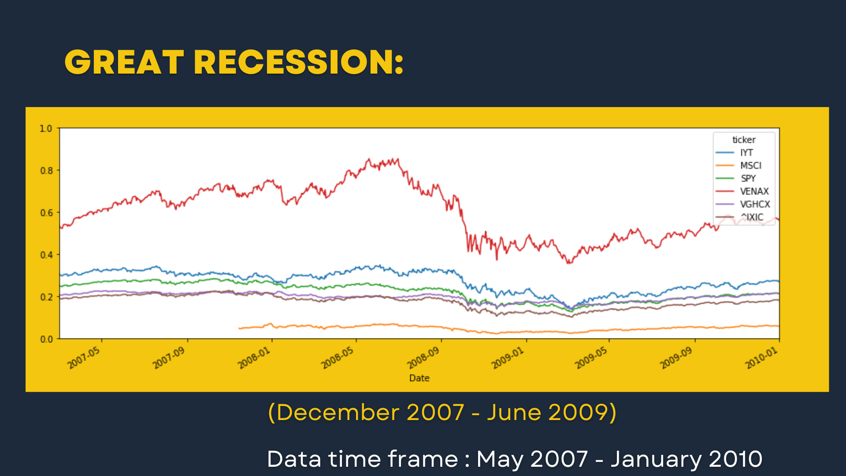
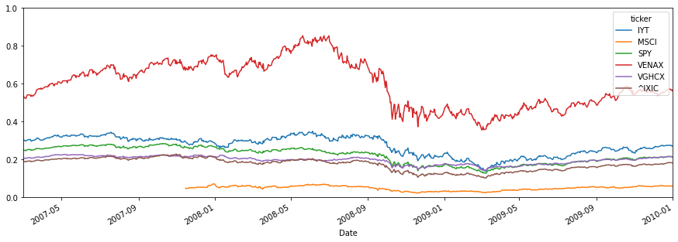
Great Recession
(December 2007 - June 2009)
Data time frame : December 2006 - June 2012

Slide 8
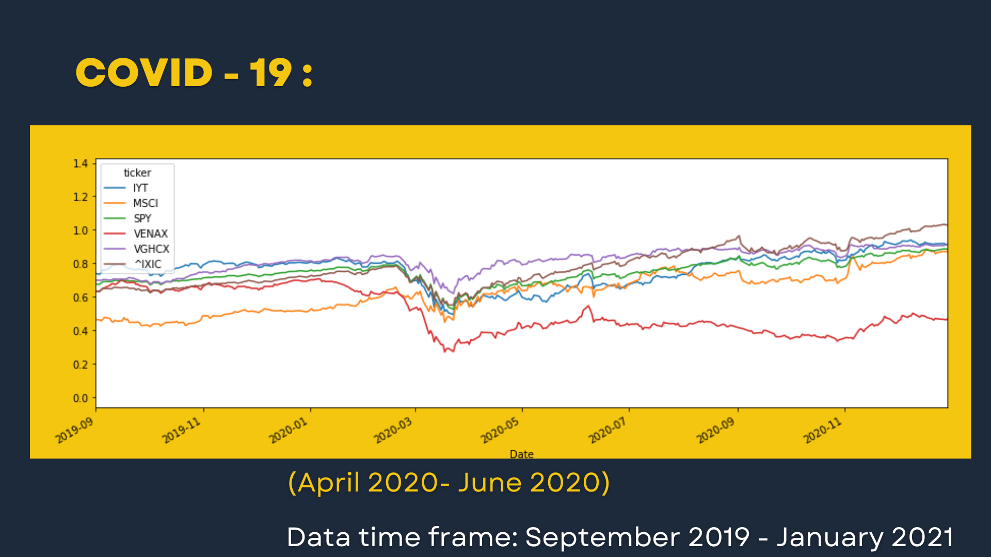
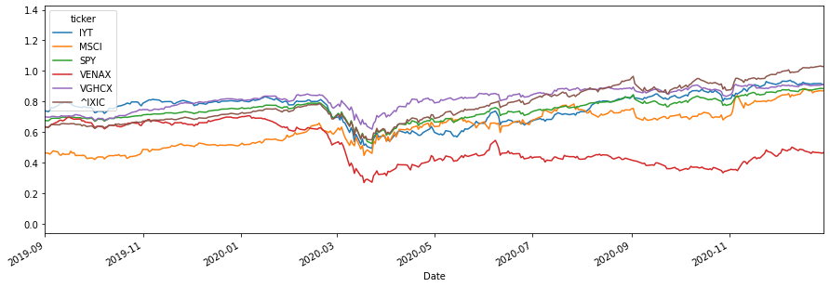
Covid-19
(April 2020- June 2020)
Data time frame: April 2019 - January 2021

Slide 9
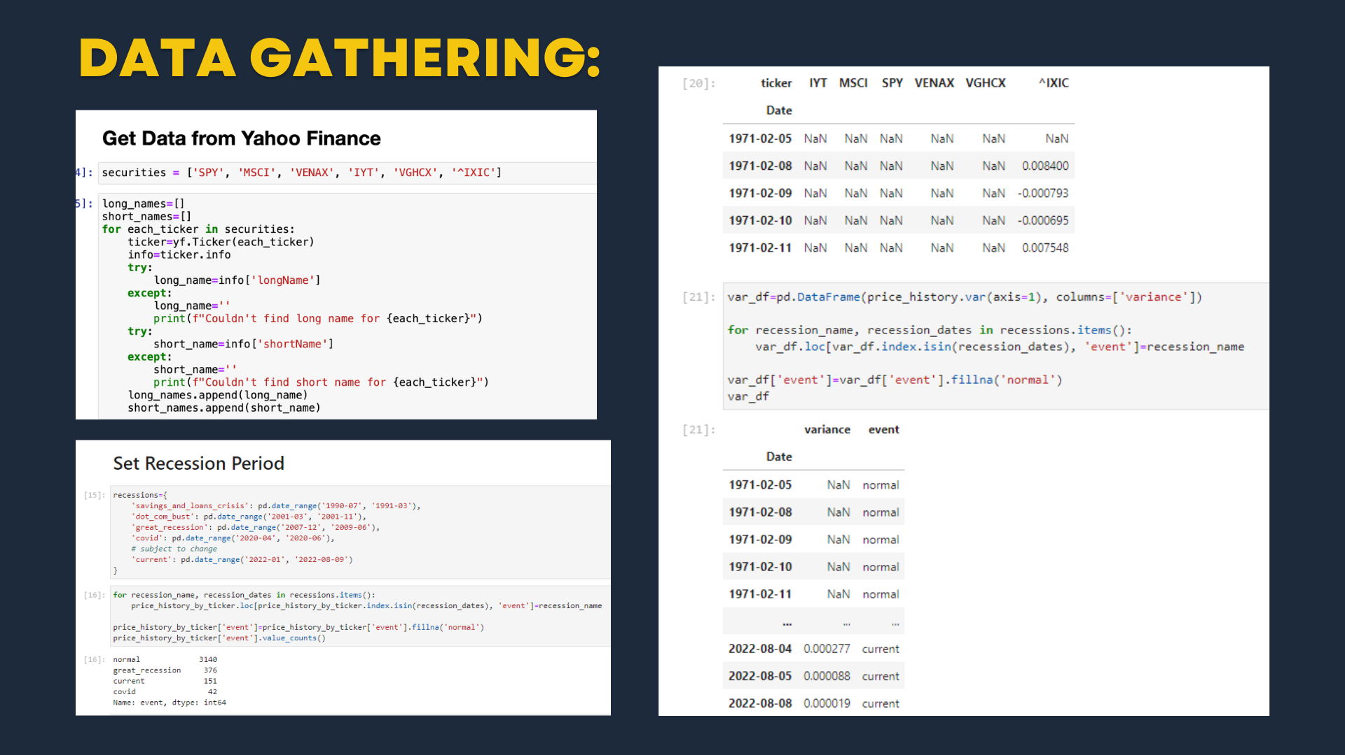
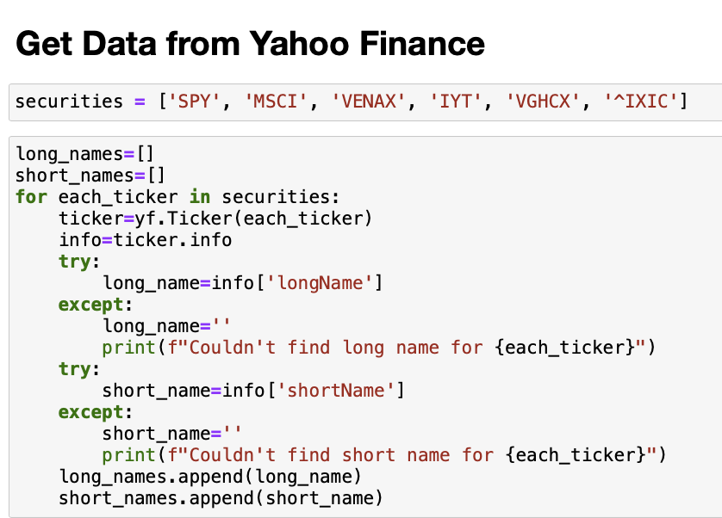


Slide 10
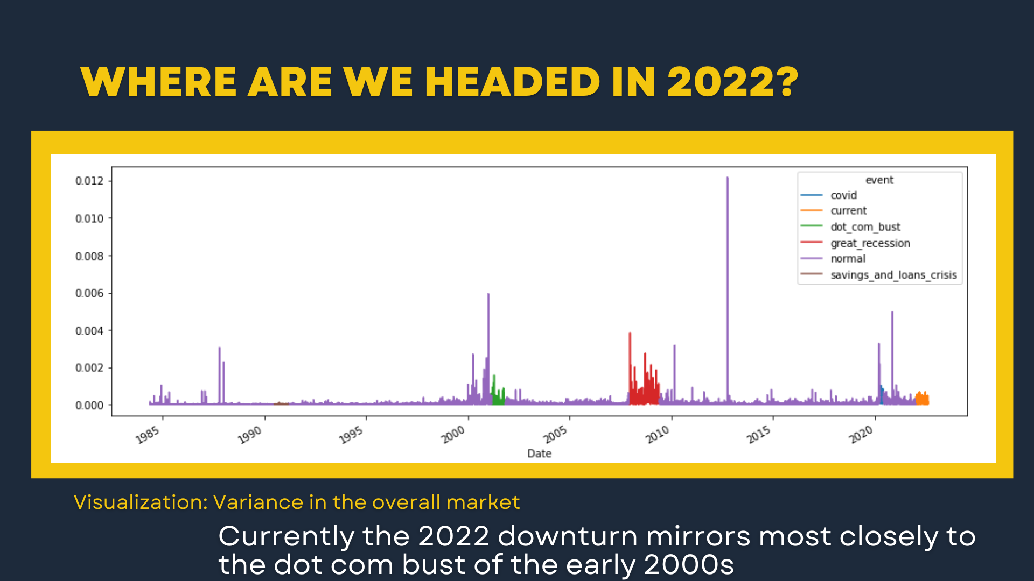

Slide 11
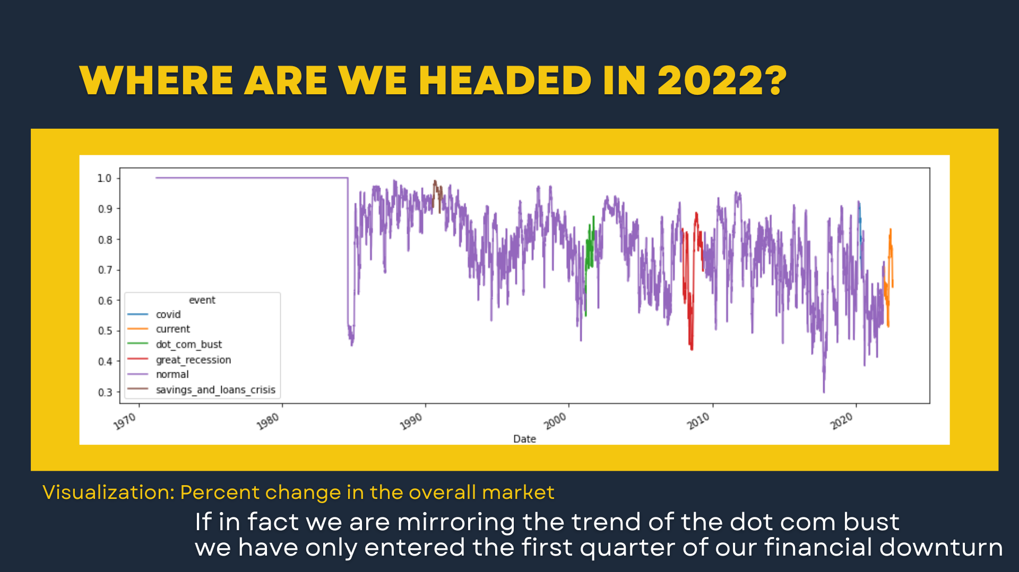

Slide 12
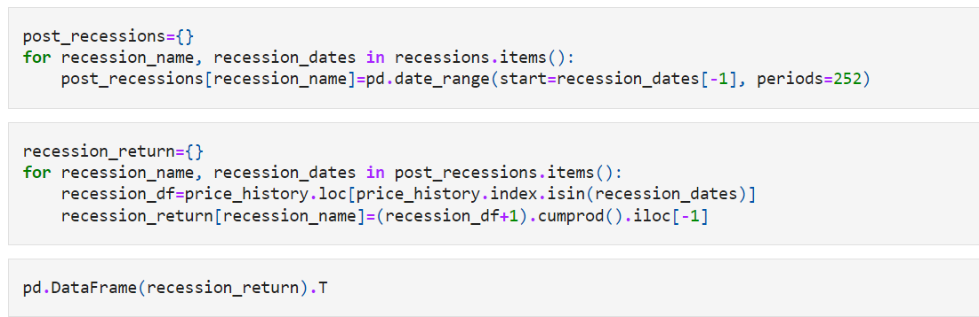
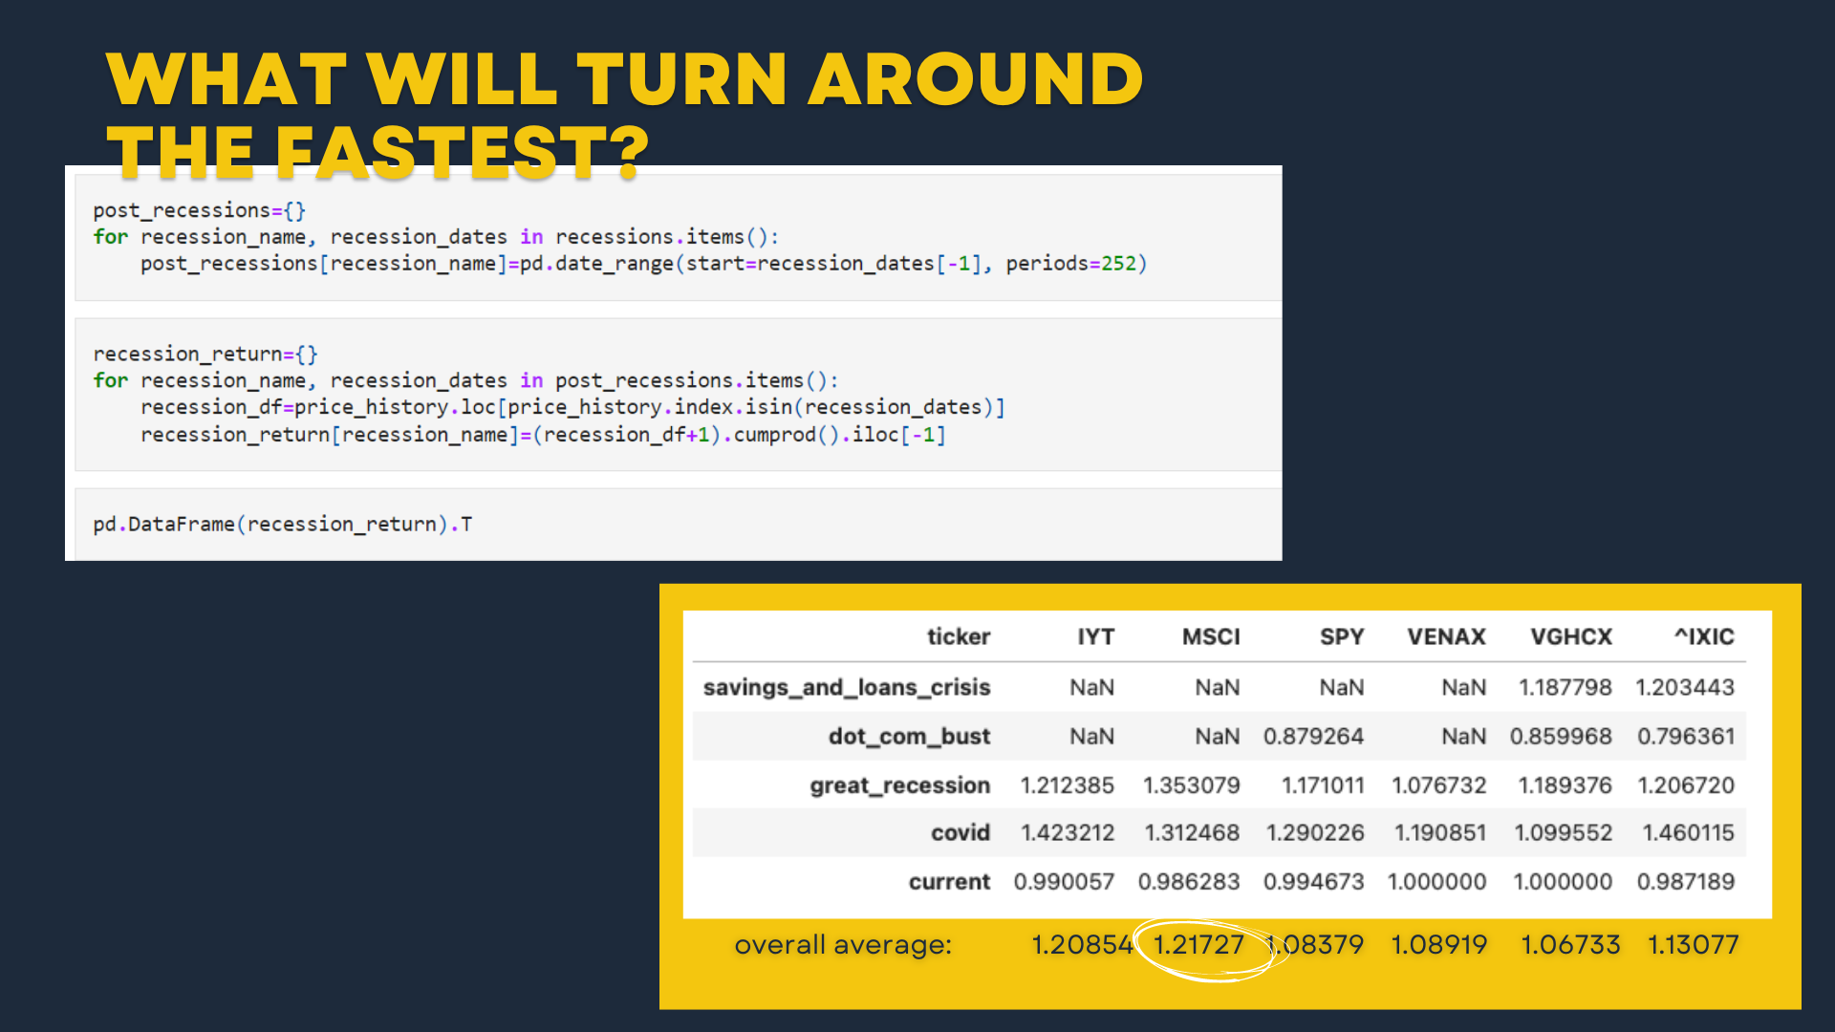

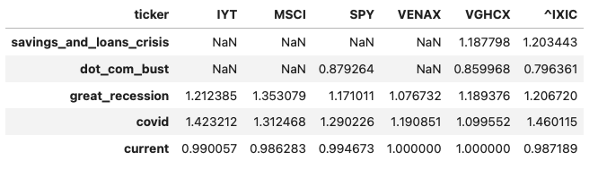
1.20854 1.21727 1.08379 1.08919 1.06733 1.13077

Slide 13

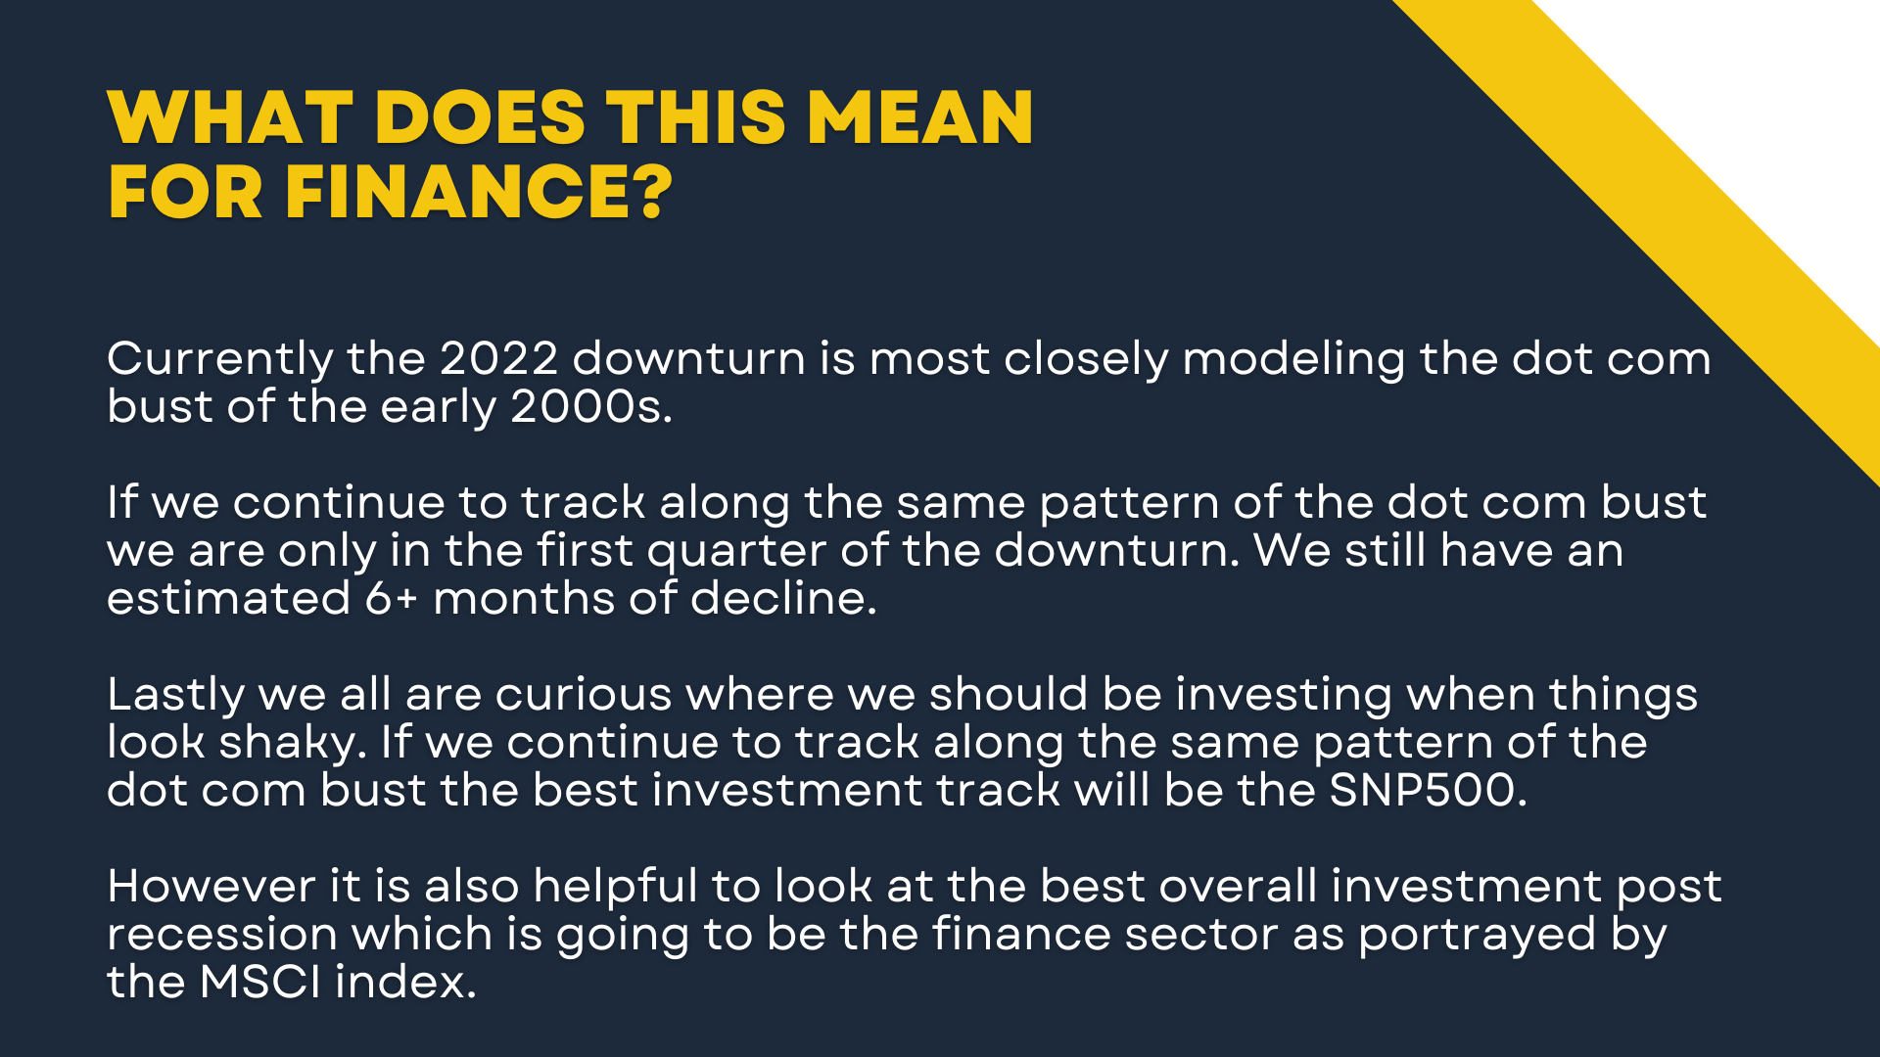
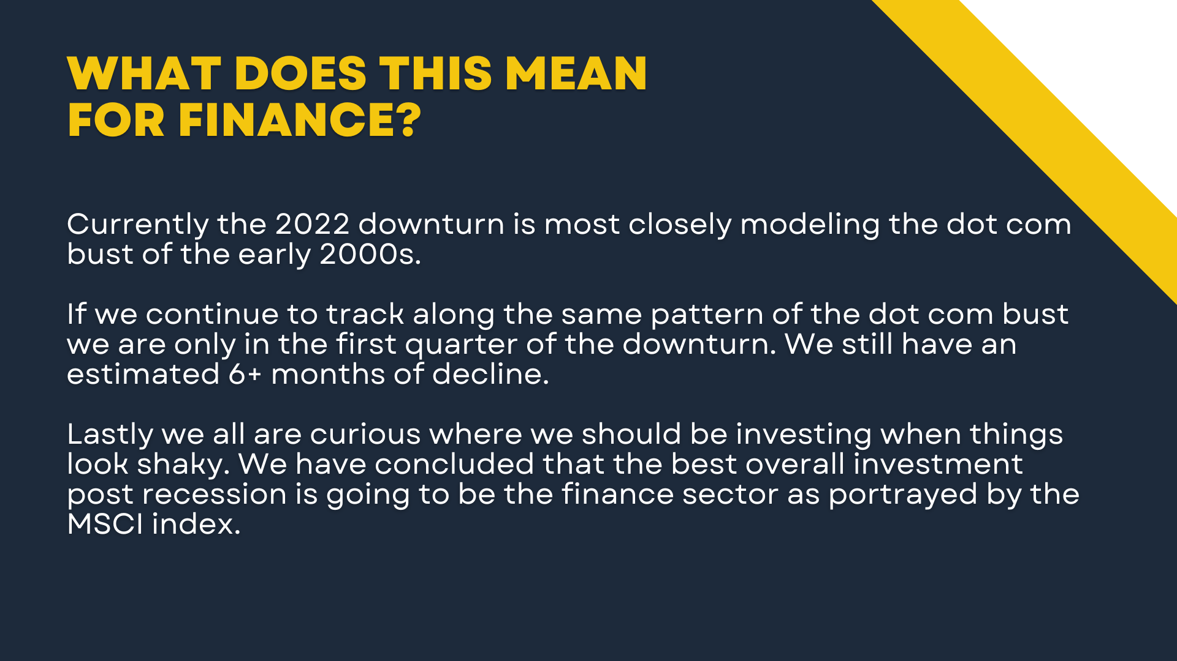
SO WHAT DO OUR FINDINGS MEAN AND HOW DO THEY IMPACT FINANCE?

Slide 14
